Slide 1
Kolkata Sanved
Facebook as a Social Media Platform

Slide 2
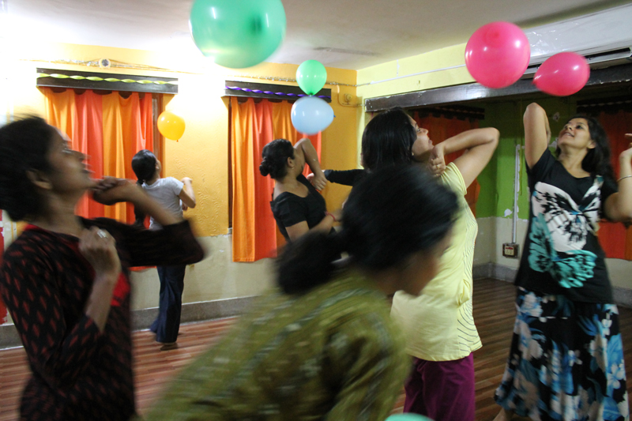
GOAL
To spread the concept of Dance Movement Therapy , as the recognition is still limited

Slide 3
GOAL
To spread Kolkata Sanved Mission and Vision of Saving Lives through Dance to Strengthen existing communication ,Create platform for online engagers to exchange thoughts, support and opinions. Sensitize and generate awareness on the issues of Human Trafficking, Gender Based Violence and Women’s Rights, to spread the concept of Dance Movement Therapy (DMT) and increase awareness about Kolkata Sanved’s work. Expand and strengthen Kolkata Sanved´s advocacy work and Increase community engagement thus Gaining a wider audience

Slide 4
GOAL
Connecting with partners / donors and organizations
Creating an interactive platform for Volunteers/Academics / Practitioners / Dancers / Partner organizations / Donors
Create opportunities for potential beneficiaries like women and youth from marginalized communities.

Slide 5
Primary Audience
Anyone interested in Human Rights / Mental Health and DMT
Donors / Partners
Academics
Dancers and DMT Practitioners

Slide 6
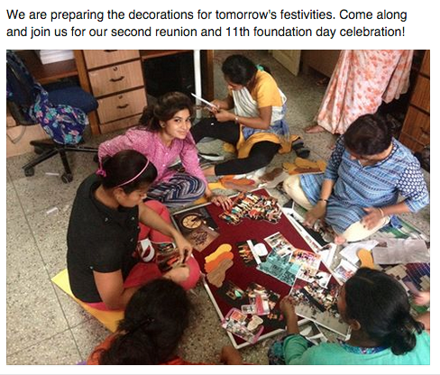
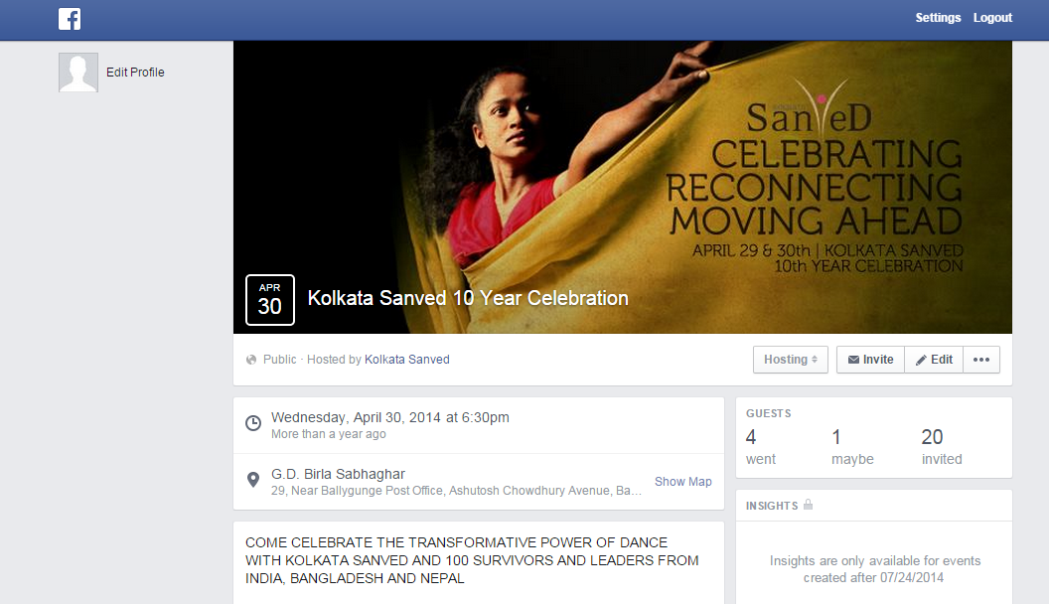
What is being shared
Kolkata Sanved recognizes opportunities to share behind the scenes material to create a personalized connection.

Slide 7
What is being shared
Photos - a clear understanding of what kind of photos to post in order to show a diversity of content. We are highlighting to post visual content as we understand how images attract viewers.
videos – advocacy / quotes and linking to YouTube channel, Instagram, Twitter and Website.

Slide 8
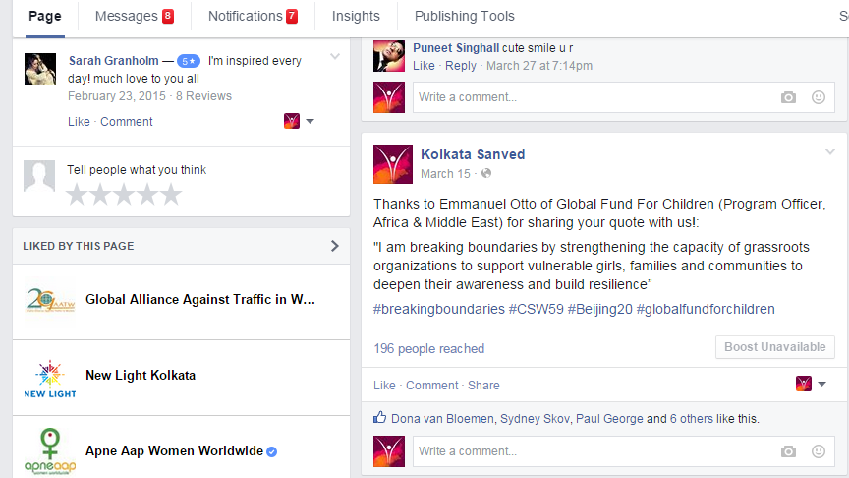
What is being shared
Quotes from visitors and practitioners to highlight their positive experiences as this shows trust and credibility.

Slide 9
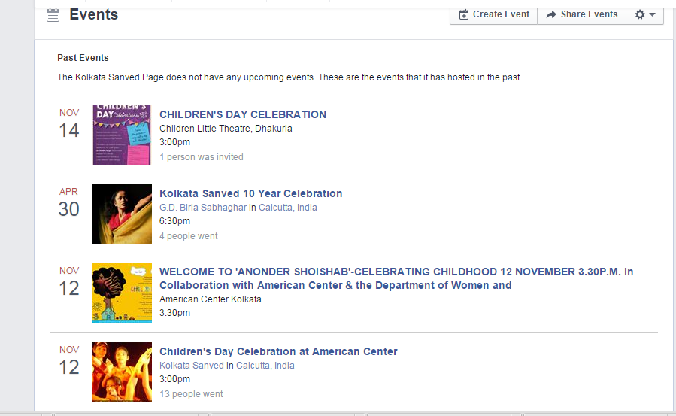
What is being shared
Promoting events

Slide 10
What is being shared
Advocacy
Links and Hash tags to other organizations as this helps reach a larger audience and interact around certain themes across organizations. On all platforms, Hash tags are being used actively. This adds to success as people are continuously searching for topics of personal relevance and by hash tagging, there is high probability that the right target population will be reached.

Slide 11
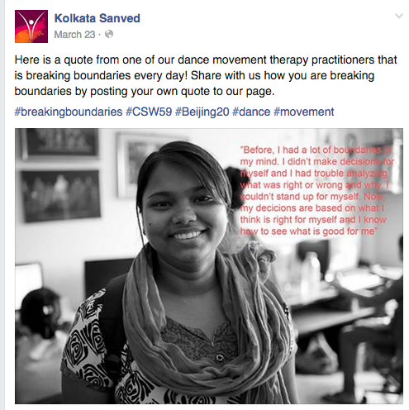
What is being shared
Campaigns – UN (Sohini Chakraborty (Founder/Director) and Sabita Debnath DMT Practioner at UN Campaign in 2015

Slide 12
Who is posting and how frequently
Volunteers / Management
3 / 4 times a week
During events and campaigns - everyday

Slide 13
Who decides information to share
Director and Management
Volunteers can come with ideas
Creative Project Manager

Slide 14
What is the review process
All posts is to be confirmed by Director Sohini Chakraborty and Creative Project Manager
Rechecked by some senior managers to check the language and grammar

Slide 15
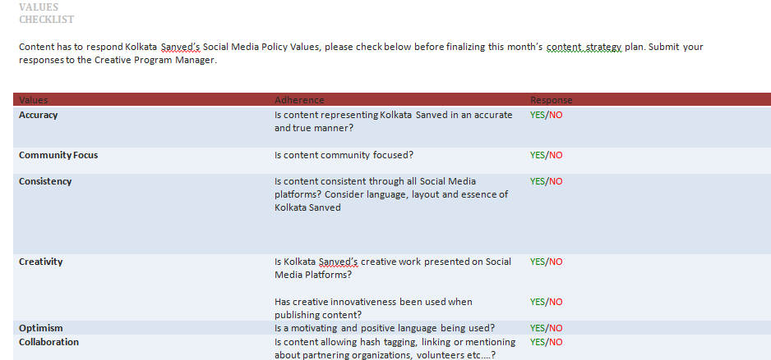
GUIDELINES
Kolkata Sanved has recently developed a guideline for it’s social media which helps structure and successfully maintain Kolkata Sanved progress and online visibility.

Slide 16
What can be changed
Getting more platform linked to face book like – LinkedIn. Through Face book encouraging people to get involved with Kolkata Sanved through campaigns , volunteering or donating money by gathering more detailed information from Kolkata Sanved website.

Slide 17
What can be changed
More frequent updates – like everyday at least 1 event / story / idea / etc
Look of the page – should be more consistent (example the cover page)

Slide 18
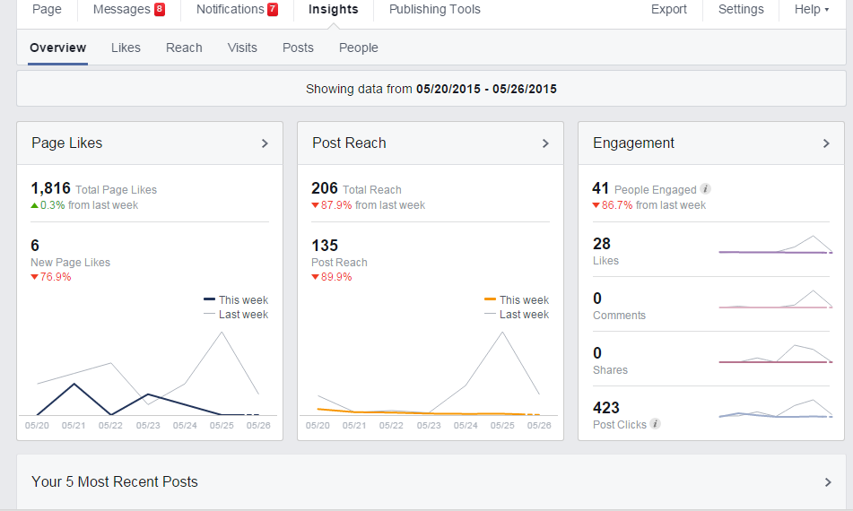
How do you measure success
By checking the insights – overview , likes , reach , visits and posts

Slide 19
How do you measure success
Under insights – under people shows a stat of gender / age and country that are interacting with our page. This is a big platform to measure our successes and to show if you are reaching the audience that you are hoping to .
By seeing the positive feedbacks on comments

Slide 20
THANK YOU

