Slide 1
Monitoring, Learning & Evaluation
Questions or problems during the webinar?
Email sellison@globalfundforchildren.org
Notes:
1. Introduction
Welcome to The Global Fund for Children’s capacity-building webinar on monitoring, learning, and evaluation for grassroots organizations. Before we get started, I want to introduce myself and the organizations that are participating today.
My name is _______ and I am [position title]. The organizations that are listening in today are [organization name] from [country], [organization name] from [country] , …. If you have any technical difficulties during the webinar, please email Sarah Ellison at sellison@globalfundforchildren.org. This information is also in the email you were sent prior to the webinar.
Throughout the webinar, I’ll be asking if you understand concepts, have questions, or have completed an activity. To respond, you’ll need to type one of three symbols into the chat box on the side of your screen. Type a plus sign (+) if you understand or have finished the activity, an equal sign (=) if you’re unsure of a concept, and a minus sign (-) if you don’t understand or you need more time.
Let’s practice now. Can each organization please type in a plus sign? An equal sign? A minus sign?
Great. If you have other questions during the presentation, please make a note of them and email them to me after the presentation ends .
Now let’s begin and talk about the goals of this webinar.

Slide 2
Learning Goals
• Learn about the benefits and value of monitoring and evaluating programs
• Understand monitoring and evaluation fundamentals, including:
Logical frameworks
Key terms and definitions
• Understand how to use monitoring and evaluation
• Become comfortable with The Global Fund for Children’s monitoring and evaluation processes for your proposals and reports
• Learn about and use data collection methods
• Discover methods for incorporating children into monitoring and evaluation procedures
Notes:
2. Goals
We appreciate you taking the time to go over this tutorial. By the end of the tutorial, we hope that you will:
-Have a clear understanding of the basics of monitoring and evaluation (M&E);
-Have an appreciation for why M&E matters and what it can mean for your work; and
-Become more comfortable with GFC’s monitoring and evaluation language and framework so that you can monitor and assess your work more effectively; write better reports and proposals; and advance your overall mission.

Slide 3
What Is Monitoring & Evaluation?
Monitoring
Evaluation
An ongoing, continuous process of counting, tracking, and collecting data.
What are the things you can measure about your program?
For example, how many children completed a training on healthy lifestyles this month?
A measure of the change that has taken place because of your program. Evaluation measures how well you have met the program’s goals.
Did your program help the people you thought it would help, or change what you were hoping to change?
For example, are the children who completed a training on healthy lifestyles healthier?
Notes:
3. Define Monitoring and Evaluation
To better understand what is meant by M&E, or monitoring and evaluation, it is helpful to look at what each word means.
Monitoring is a systematic collection and review of data.
When you monitor, you collect data intentionally. You determine what information you need in order to show that you’re doing your work and meeting your goals. You collect that information or data on an ongoing basis to see if you are making progress toward your goals and objectives.
For example, if your goal is to send children to college, then one piece of information you will need to know is how the children are performing in school. You can collect this data from teachers or schools, and you can observe it over time to identify some children who may need extra assistance. This data can also help you tell your organization’s story to donors or other stakeholders in words and in numbers—such as numbers that indicate how many children you serve and how the children are performing in school.
After doing the work and collecting the data, you then use that information to evaluate your work in order to see if you have in fact met your goals and made a difference in the lives of the children and community you serve.
Evaluation is a systematic analysis of data that draws conclusions about the effectiveness of your project. It is a measure of the change that has taken place since you’ve conducted your program.
When you evaluate, you determine if you are meeting the long-term goals of your project. Evaluation helps you look at your work over time and find out if you’ve made a significant change in your program participants.
For example, are students in your program more likely to succeed in school and attend college than children not in your program? To determine the impact of a program, some organizations use external evaluators or skilled staff members. Evaluation can be done one time, at the end of a project, or it can be an ongoing study. In all cases, evaluation is a way to learn from what has happened, look at it objectively, and use that knowledge to make informed decisions about the future of your work.

Slide 4
Write down three ways your organization can benefit from monitoring and evaluation.
Why Monitoring & Evaluation?
Use resources well.
Make good decisions for project changes.
Now You!
M&E helps you answer these questions:
• Was the program completed as planned?
• Did the target population benefit from the program, and at what cost?
• Which program activities were most effective, and which were least effective?
[2 minutes]
Notes:
4. Why M&E?
Why do organizations spend time doing monitoring and evaluation?
Here are a few reasons:
-M&E helps you make decisions based on objective data.
-M&E ensures the most effective and efficient use of your time and money.
-M&E meets organizational reporting and donor requirements.
-M&E helps you answer the following questions:
-Was the program implemented as planned?
-Did the target population benefit from the program, and at what cost?
-Which program activities were most effective, and which were least effective?
How could your organization benefit from improved monitoring and evaluation? Take two minutes, as a group, to write down your answers under question 1 of the worksheet.
[After 1.5 minutes, ask if everyone has finished. Ask them to type in a “+” if they have finished and a “-” if they haven’t finished. Advance to the next slide at the end of two minutes.]

Slide 5
Two Types of Evaluation
Formative: A formative evaluation is a method for evaluating a program while the program activities are in progress. This kind of evaluation focuses on the process of implementation.
When Used: During the program or project
What It Tells Us: How well the program is being implemented
Summative: A summative evaluation is a method for assessing the success of a program at the end of the program activities. The focus is on the outcome.
When Used: At the end of a program
What It Tells Us: If the objectives were achieved
Formative
Summative
Notes:
5. Formative and Summative
There are two types of evaluation: formative and summative.
A formative evaluation evaluates the success of a program while the program activities are forming, or in progress. This kind of evaluation focuses on the process. Because of this, it is also called a process evaluation.
A summative evaluation judges the worth of a program at the end of the program activities —think of it as summing up, or summarizing, the program as a whole. The focus of a summative evaluation is on the outcome. When most people talk about evaluation, they mean a summative evaluation, and it is this kind of evaluation that we will focus on in this webinar.

Slide 6
Key Words to Know
Input: Funds, technical assistance, and other resources needed to complete a project.
Activity: Actions taken or work performed in a project to produce specific outputs by using inputs.
Output: The tangible (easily measurable, practical), immediate, and intended results to be produced through management of inputs.
Outcome: The intermediate effects, often behavioral, resulting directly from project outputs.
Impact: Changes in the condition of the people who benefit from your work, particularly changes reflecting the goal of the project.
Indicator: A variable that measures a single aspect of the project that is directly related to the program’s objectives.
Stakeholders: Individuals or organizations associated with or affected by a project.
Baseline information: Information collected at the initial stages of a project that provides a basis for measuring progress.
Beneficiaries: The individuals, groups, or organizations that benefit directly or indirectly from the intervention. The main intended beneficiaries of a project are sometimes called primary stakeholders.
Qualitative: Something that is not summarized in numerical form. Qualitative data normally describes people’s knowledge, attitudes, or behaviors.
Quantitative: Something that is measured, measurable by, or concerned with quantity and is expressed in numbers.
Notes:
6. Key Words
There are many systems and tools used to monitor and evaluate programs. There is no one “best” M&E tool, but the key terms that are listed on this slide are commonly used in M&E, including for GFC. Outputs are often associated with monitoring, and outcomes are associated with evaluation.
You are most likely familiar with the first five terms. These are also the main components of a logical framework. They are “input,” “activity,” “output,” “outcome,” and “impact.”
The next five definitions may be helpful in designing monitoring and evaluation plans and reporting on programs. Take a moment to look through them. [Allow one minute.]
Finally, take a look at the last two terms. Indicators can be either quantitative (numeric and presented as numbers or percentages) or qualitative (descriptive observations).
Please note that for GFC’s purposes, the most important term is “outcome,” because this is what we will be asking you to track and report on over the course of your GFC grant implementation.

Slide 7
The Logical Framework
INPUT (Resources)
Time Money Donors Equipment Facilities
ACTIVITY/ PROGRAM (Interventions)
Services Trainings Home Visits Classes Sessions
OUTPUT (Direct result from interventions)
Who did we reach? (# and population) What did we do? (action and duration/ frequency)
OUTCOME (Change in participants, result of your project)
Behavior Awareness Knowledge Skills Practices Attitude
IMPACT (Change in society)
Environment Social condition Political condition Economic condition Policy
Before
Activity
After
Change = Outcome
Notes:
7. The Log Frame
The key words we just looked at are the main components of the logical framework, or log frame. The log frame helps us organize our thoughts and activities so we are able to tell others about our project and how it helps children. The logical framework is a structure used to organize the way you plan, report, and evaluate programs.
Below each key word are examples.
A good way to understand what an outcome is, is to think of it as the change that takes place in participants. Before, the participants were like _______; then the activity and program occurred. After the activity, the participants changed and became like ________. The outcome is the change that happens as a result of the activity.

Slide 8
Logical Framework: Example
University enrollment increases
90% of students in the after-school tutoring program pass the end-of-year exam
20 hours of after-school math lessons are provided
After-school tutoring is offered
Tutors are hired and classroom space is secured for tutoring
Many students are not able to attend university because they are unprepared for the end-of-year exam
IMPACT
OUTCOME
OUTPUT
ACTIVITY/PROGRAM
INPUT
PROBLEM
Notes:
8. Example 1
Here’s an example of what a logical framework might look like for one organization that does after-school tutoring.
It starts at the bottom of the page, with the problem that the community faces. [Read problem.]
Next comes the input. [Read input.]
Then, the activity/program. [Read activity/program.]
From the activity, there are outputs. [Read output.]
From the outputs come outcomes. [Read outcome.]
Finally, this results in the impact. [Read impact.]

Slide 9
Logical Framework: Your Turn
Now You!
PROBLEM
Secondary-school completion rates for girls are low
[5 minutes]
95 out of 100 girls complete their secondary- school education
More girls pursue higher education at university
$800 raised to fund scholarships
Scholarships for girls to attend secondary school
100 girls receive academic scholarships
1.
2.
3.
4.
5.
IMPACT
OUTCOME
OUTPUT
ACTIVITY/PROGRAM
INPUT
Notes:
9. Matching Practice
Now it’s time to practice. Match each part of the program description on the left with the corresponding key word on the right. Look at question 2 on the worksheet if you want to draw lines to connect the descriptions and key words. You have five minutes.
[At three minutes, ask participants to tell you if they are finished or need more time, using + or -. Once the five minutes are up, click to reveal the answers and discuss.]

Slide 10
More to Know About the Logical Framework
Pros
Organizes your activities and describes your model
Identifies what you should measure
Communicates your objectives clearly
Cons
Doesn’t show complexity and nuances
Is “one size fits all”
Notes:
10. More to Know
The logical framework has its benefits, but it doesn’t account for everything. Let’s talk about some of the pros and cons of using a logical framework.
Pros
Helps you organize ideas and thoughts to express them to other people who might be interested in your programs.
Shows you what you should be measuring to determine if you are achieving your goals, and clearly states your outputs and outcomes.
Makes your main goals and objectives clear to anyone who is interested in your outcomes and impact.
Cons
Your programs may not fit perfectly into the model. There may be multiple steps to your project or there may be several steps that are reoccurring or happen simultaneously.
The logical framework does not consider the larger community and context within which your project operates. It is “one size fits all.”

Slide 11
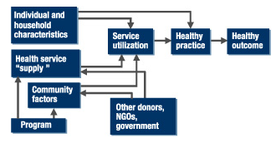
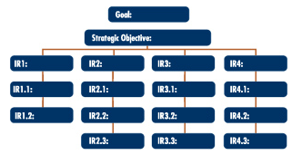
Alternative Frameworks
Conceptual Framework
Results Framework
Shows relationships
No universal format
Pro: Flexible and identifies most important factors influencing project
Con: Doesn’t give a clear outline for M&E planning
Direct causal relationships
Linear format used by USAID
Pro: Provides clear framework for M&E as each IR (incremental result) is measurable
Con: Linear model that doesn’t account for interactions
Notes:
11. Alternative Frameworks
Because the logical framework doesn’t fit every program or project, it is important to consider other frameworks that may help your organization build better operations. Here, you see the two other most commonly used frameworks.
The conceptual framework, which is also called a research framework, gives organizations an overall sense of the factors that influence the outcomes of a program. Conceptual frameworks are usually arranged as diagrams showing relationships and causal linkages. There is no standard format for conceptual frameworks, and each organization develops its own. This framework is least helpful for determining where in the process monitoring and evaluation takes place, and it is most helpful for identifying which variables are most important to a project’s outcomes.
The results framework, on the right-hand side of the slide, is sometimes called a strategic framework or a performance monitoring plan, and it is used by USAID. This type of framework diagrams the direct causal relationships between the incremental results, or IRs, of the key activities all the way up to the overall objective and goal of the intervention. Each of the IRs and sub-IRs need to be measurable; in other words, indicators can be developed for them and data can be collected to calculate these incremental results for monitoring and evaluation purposes. The strength of this framework is that it clearly indicates the incremental results that should be monitored along the way. A weakness is that it is a very linear approach and doesn’t account for relationships between variables.

Slide 12
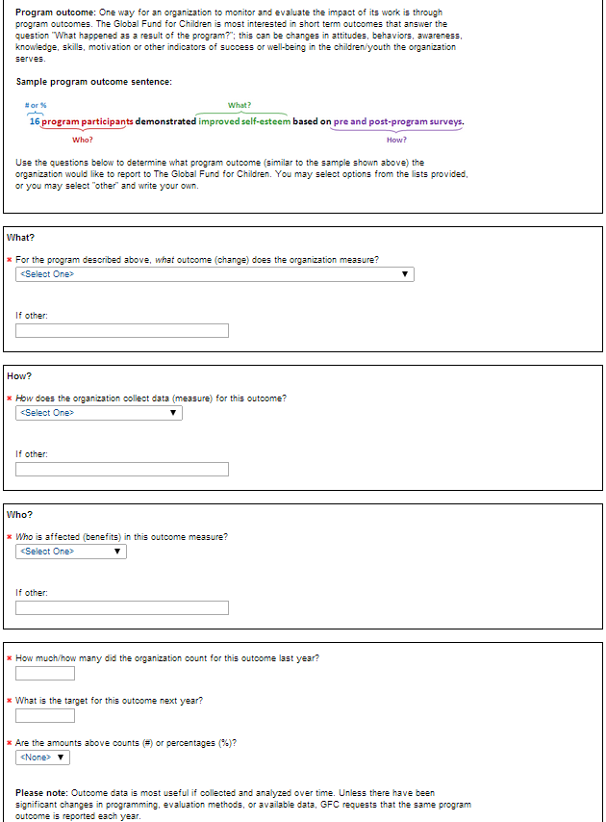
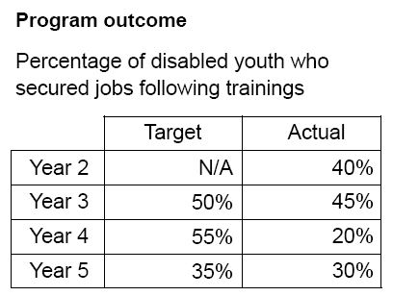
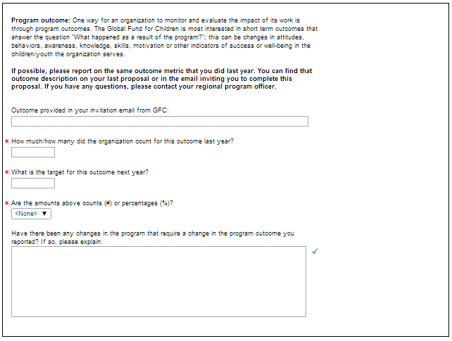
M&E for GFC: Outcome Sentences & Reports
Notes:
12. M&E for GFC
When filling out the grant application for GFC each year, you are required to input information about outcomes that your organization will report on to GFC. The outcome questions on the application are based on the logical framework and help you to determine what the key outcome of your program is and how well you are achieving it.
When filling out the initial request for a grant from The Global Fund for Children, you are asked questions like the ones shown here. [Click to advance, and the image will appear.] These first questions help your organization and your program officer to determine what you will report to The Global Fund for Children during your entire funding relationship with GFC. The questions are designed to help you develop a one-sentence program outcome that states what your organization does (the key goal/outcome), how your organization accomplishes this goal (activities and programs), who your organization serves (the specific population of children you work with), and how many children you have reached in the past year and hope to reach in the coming year. There are drop-down categories that can guide you, or you can type in your own answers. We’ll talk more about the creation of outcome sentences in the coming slides. [Click to advance, and this image will disappear.]
[Click to advance, and a new image will appear.]
For renewal and final grant applications, you are asked to report on the outcome that was determined by you and your program officer during the first year of your grant. In rare cases, the program outcome that an organization reports on may change, but this is not usual and makes monitoring your progress as an organization more challenging. When you report the number or percentage of children impacted by your program in your application, this information is sent to the staff and board of GFC so they can review your progress in a grant recommendation form. [Click to advance, and an example image will appear.]
For example, this organization reports its outcome as a percentage. [Read the program outcome in the example box.] As you can see, the organization’s success in increasing that percentage and reaching its goal varies from year to year. Accurately collecting this data for your outcome is a very important part of the application process.
Now let’s look at what makes a great outcome sentence both for GFC grant applications and for other potential donor applications.

Slide 13
Outcome Sentence for GFC
# or % (4)
What? (1)
Last year, 66% of program participants were successfully enrolled in formal school, based on statistics from local schools.
Who? (3)
How? (2)
1. For the program you run, what outcome (change) does the organization measure?
2. How does the organization collect data for (measure) this outcome?
3. Who is affected (benefits) in this outcome measure?
4. How much/how many did the organization count for this outcome last year?
What
How
Who
When
How many
Notes:
13. Outcome Sentences for GFC
Here is the formula that GFC uses in its grant application or “proposal”. The grant application asks you questions to help you create an outcome sentence. Notice how the example outcome sentence is SMART.
Specific – enrolled in formal school
Measurable – statistics from local schools are used to calculate the percentage of school-going children (66%) in the program
Appropriate – program participants (not others) (We assume that this project meets the needs of the program participants.)
Realistic – depends on the organization—is 66% achievable?
Timely – one year (“last year,” which is GFC’s standard outcome period )
The questions that GFC asks to help you determine your outcome sentence are:
1. For the program you run, what outcome (change) does the organization measure?
2. How does the organization collect data for (measure) this outcome?
3. Who is affected (benefits) in this outcome measure?
4. How much/how many did the organization count for this outcome last year?

Slide 14
Practice: Write an Outcome Sentence for GFC
Now You!
[6 minutes]
Use the questions below to determine what program outcome your organization would like to report to The Global Fund for Children.
1. For the program you run, what outcome (change) does the organization measure?
2. How does the organization collect data for (measure) this outcome?
3. Who is affected (benefits) in this outcome measure?
4. How much/how many did the organization count for this outcome last year?
Last year, _(4)__ of (3) were (1) , based on (2) .
Notes:
14. Practice Writing an Outcome Sentence
[Give examples from past grant applications (chosen by the program officer).]
Now it’s your turn to work on a project outcome sentence for your organization. Work as a group and decide what your outcome sentence will look like. You have six minutes. If you’re not sure about your sentence or would like help with writing it, make sure to email your program officer later with your sample and any questions you have. Look at question 3 on the worksheet.
[After three minutes, ask participants to tell you if they’ve completed the activity, using + or -.]

Slide 15
Collecting Data
Why?
Makes monitoring and evaluation possible
Where can you get data from?
Your own records
Local organizations
Tools: Questions to consider
Who collects the data, how is it collected, and when is it collected?
Where is the data stored, and how is it organized?
Other resources:
My M&E website on how to collect data:
http://www.mymande.org/howto-recomm-page?q=node/94
Keep track of the resources, number of participants, and what happened during your program in a consistent and repeatable way.
Notes:
15. Introduction to Collecting Data
You can collect data from a variety of sources. Most organizations collect data by keeping good records of things like attendance, participation, surveys, and financial records.
You can also work with other local organizations, either NGOs or the government. For example, you can talk with schools about pass rates or clinics about overall statistics.
To collect good data, you need to have the right tools. Often the right tools means collecting data in a way that no matter who collects the data, it will be the same. Data should be collected in the same way each time. It helps if you set up a procedure so that you know who is collecting data, when they will collect it, and how they will collect it.
For example, if you want to count the number of children who attend your after-school programs throughout the week, you should know who will make sure all of the children sign in each day and when they will be required to sign in, and you should make sure that they are using the same form each time. That way, you can compare information from month to month and year to year.
After data is collected, you have to know how it will be stored and organized. For different organizations, that could mean different things, but it often means having a spreadsheet in Excel or in another computer program that has all of the information and is updated often.
Finally, it is important to use the data you’ve collected. By having data over a period of time, you can see trends and make decisions based on what you find. For example, you may notice that not as many children come to a soccer practice on Mondays, but you have almost too many children attending soccer practice on Saturdays. After speaking with the children to determine why this is, you can change your program by having more coaches on Saturdays and either changing the time of the Monday practice or having less coaches on Mondays.
Here are three common challenges to collecting data:
-First, not all outcomes are easily countable. There might be changes in behavior or attitude that have to be measured in different ways.
-Second, some outcomes take more than a year to become evident.
-Third, it can be difficult to measure what the impact of your program is. For example, it’s fairly easy to tell how many of the children you work with are going to school, but if you are trying to reduce trafficking, how do you measure your influence in that area?
For more information on how to address these challenges, see the link provided on this slide and the other resources on the next slide.

Slide 16
Data Collection
Sources
Attendance Sheets
(After-School Project)
Telephone Calls
(Reunification Project)
Collection Method
Every day at 4:00 p.m., each child signs in with his or her first and last name and age. At the end of the activity, the staff member puts the information on a spreadsheet.
A program officer calls to find out if a child has been reunited with his or her family. At the end of each phone call, the child’s status is recorded on a spreadsheet.
Why?
Collect the data to use it . . .
To write reports
To help you make decisions about your programs
To create the best programs possible
To know that you are achieving your goals
Resources:
http://learnmandeforum.com/?s=Data+Collection
http://mnestudies.com/monitoring/methods-tools-collecting-me-data
Notes:
16. Data Collection
To collect good data, you need to know where your data is going to come from (the source) and how you will collect it (collection method).
Here are examples of how two different projects collect the data they need.
[Read examples.]
It is important to measure the same things from year to year so you can see the progress you are making toward your overall goals. The first time you collect data, it is referred to as “baseline data.” Baseline data is ideally collected at the beginning of a project and provides a basis for measuring progress.
For more information on how to collect data, click on the resources on the left side of the screen.

Slide 17
Data Analysis
Types
Tools & Resources
Quantitative
Counts or calculates numbers, percentages, frequencies, means, or medians to answer “How many?”and “How much?” questions.
Qualitative
Analyzes the data in a descriptive manner to answer “Why?” and “How?” questions. This requires identifying the categories or themes in each response and analyzing them in relation to qualitative indicators.
Most organizations use basic resources such as Excel.
More advanced software is available in the form of Stata, SPSS, and SenseMaker.
Examples of Data Analysis
Hans Rosling on HIV: New Facts and Stunning Data Visuals
BBC Podcast on Statistics
Using Excel for Analysis and Reporting (Webinar – 1 hour)
Basic Data Analysis (Webinar – 1 hour)
Notes:
17. Data Analysis
There are two types of data analysis: quantitative and qualitative.
Quantitative data focuses on things you can count, like numbers and percentages.
Qualitative data focuses on things you can observe but that are hard to count, like changes in behavior and attitude. Measuring these things is often done through interviews, diary entries, or other non-countable data. You’ll need to decide in advance which themes or categories in the responses or observations will count toward each qualitative indicator.
There are a variety of tools and resources that organizations can use to help them make sense of their data. The most common tool used for quantitative analysis is Excel. For more-advanced analysis, some organizations use software like Stata, SPSS, and SenseMaker.
For more examples on ways you can analyze and learn from your data, click on the links on the right-hand side of the screen. After the webinar, you will be able to download this presentation so that you can click on the links shown in this slide.

Slide 18
With the Help of the List Below, Identify the Tools You Could Use to Collect Data
Now You!
[7 minutes]
Sign-in Sheets Surveys Conversations Interviews Focus Groups
School Reports National Reports and Statistics
Health Center Information Research Results Diaries Legal Records
Media Coverage Published Articles Photographs
Videos Trade Unions Local Government Records Behavior Change
Data Plan
Who on your team will be responsible for collecting data and using it to make your programs stronger?
The person who will collect this data is ________________.
He/she will collect it every ________ (day, week, month, etc.).
We can use this data to tell us __________, and it will help us to improve ___________.
After the data has been collected, it will be stored _________ (where) and will be organized by ________ (whom).
Notes:
18. Make a data plan!
Look at question 4 on the worksheet. Circle the different sources and tools you can use to collect data about your programs. Discuss in your group which sources best measure the impact you are trying to achieve.
After your group finishes question 4, complete the data plan under question 5. You can use this plan in your organization starting tomorrow! You have seven minutes to complete these two activities.
[After three to four minutes, ask the participants to tell you if they have completed the activity, using + or -.]

Slide 19
Involving Children in Monitoring & Evaluation
It’s a child’s right
Non-representative adults
Mutually beneficial
Requires resources
Do no harm
Sensitive issues
Developmentally appropriate
Why involve children?
Risks and challenges.
Informed consent
Safety
Clear expectations
Power dynamics
Balance and support
Adults should be open to learning
Discuss organizational capacity
Discuss how children will benefit
Determine children’s interest in participation
Things to keep in mind.
First steps to take.
Notes:
19. Children in M&E
Involving children in the actual monitoring and evaluation of your programs can be mutually beneficial, but it comes with challenges and risks.
Let’s start with the positive side. Why might you want to involve children in M&E?
First, according to article 12 of the UN Convention on the Rights of the Child, participation is a right of all children.
Second, adults who speak on behalf of children aren’t always accurately representing the children’s views, even when they have the best intentions.
Third, it is beneficial to both the children and the organization. For the children, it increases their sense of ownership of the project; develops their sense of social justice, their self-esteem, and their relationship with adults; and increases their resilience. It’s an opportunity for children to gain a wide range of skills and become active members of their community. At the same time, the organization benefits from the valuable information that the children have to offer about their own experiences. The decisions of the organization become more transparent and reflective of the community’s needs. Because of this, programs are more likely to be broadly adopted and supported by the community.
There are also risks and challenges associated with involving children in monitoring and evaluation.
First, it requires a lot of resources to train staff in appropriate methods for working with children in this capacity.
Second, you must be aware of the other constraints the children are facing, and you need to make sure that your project does not overburden the children.
Third, it is important to acknowledge the environment within which the program is operating. Putting children at odds with community traditions or expectations can have adverse effects that the children might not have the resources to cope with.
Finally, the level of the children’s involvement should reflect their developmental stage. For example, younger children may be more impacted by challenges that the program might face.
Here are some other things to consider when involving children in monitoring and evaluation:
Their participation must be voluntary, free of manipulation, and undertaken with the approval of a parent or guardian.
The context in which the children are participating must be “child friendly.” This includes safety, accessible tools, appropriate language, trained facilitators, etc.
The children and the organization must both be clear about what is expected from the collaboration. It is important to define to what extent the children will be involved, how much decision-making power they will have, and how long their involvement will continue.
Power dynamics are also important to consider. Nondiscrimination and inclusivity must be part of the design, and issues relating to adult-child and child-child power dynamics must be addressed prior to involving children.
Finally, to keep children involved and benefiting from participation, there must be a balance between work and play. Adequate support needs to be provided for children to help them make sense of their experiences.
First steps for your organization to take when considering the involvement of children in your monitoring and evaluation process include the following:
Adults in your organization must have an open attitude to learning from and listening to children in a meaningful way. Ask “What do we need to know?” and “How can we find this information?” If children can inform these questions, it is important to seek their expertise.
A frank discussion about the capacity of your organization to support these children is also important. What role will they play? Who can support them? How will you ensure their safety and address the other previously mentioned challenges?
The children must be active participants in the process; otherwise, they will not be benefiting. It is important not to instrumentalize or trivialize the children’s voices. Determine exactly how they will benefit and how you will use the information they provide.
To incorporate children, there must be interest in participating from the children and openness on the part of staff. Ask your child or youth participants if they truly want to be involved in the monitoring and evaluation process.

Slide 20
Additional Resources
M&E Learning Center
https://training.measureevaluation.org
My M&E
http://www.mymande.org/elearning
Global Health E-Learning
http://www.globalhealthlearning.org
Children & Evaluation
http://betterevaluation.org/themes/evaluation_and_children
M&E Studies
http://mnestudies.com
Pan Asia-Africa RBM&E Forum
http://learnmandeforum.com
Notes:
20. Additional Resources
Here are some additional resources to help you learn more about monitoring and evaluation. There are more webinars and tools available to help you collect data and measure your impact. This is not a complete list of all of the resources available; if you know of another great M&E training, please let us know so we can share it with other grantees. After the webinar, you will be able to download this presentation so that you can click on the links shown in this slide.

Slide 21
Please write down three changes you can make that will improve M&E for your organization.
What Did You Learn?
What changes can you make in your work today?
Now You!
[5 minutes]
Notes:
21. Reflection
We’ve talked about a lot of different subjects during this webinar. Take five minutes and write down three changes you can make in your programs today, on question 6 of the worksheet. You’ll be asked to write these down again on the survey at the end of this webinar, so think hard!
[After three minutes, ask participants to tell you if they’ve completed the activity, using + or -.]

Slide 22
Thank you
Please take the follow-up survey!
Contact: Sarah Ellison
sellison@globalfundforchildren.org
Notes:
22. Thank you
Thank you for participating in this webinar. In order to receive your ML&E certificate from GFC, you must complete the survey link: https://www.surveymonkey.com/s/7MY8QR8.
[Type link into chat box.]
Please click on the link in the chat screen, and it will take you to the survey now. If you have any questions about the information we talked about today, please do not hesitate to contact your regional program officer. Thank you!

