Slide 1
Monitoring, Learning & Evaluation
Questions or problems during the webinar?
Email sellison@globalfundforchildren.org
Notes:
1. Introduction
Welcome to The Global Fund for Children’s capacity-building webinar on monitoring, learning, and evaluation for grassroots organizations. Before we get started, I want to introduce myself and the organizations that are participating today.
My name is _______ and I am [position title]. The organizations that are listening in today are [organization name] from [country], [organization name] from [country] , …. If you have any technical difficulties during the webinar, please email Sarah Ellison at sellison@globalfundforchildren.org. This information is also in the email you were sent prior to the webinar.
Throughout the webinar, I’ll be asking if you understand concepts, have questions, or have completed an activity. To respond, you’ll need to type one of three symbols into the chat box on the side of your screen. Type a plus sign (+) if you understand or have finished the activity, an equal sign (=) if you’re unsure of a concept, and a minus sign (-) if you don’t understand or you need more time.
Let’s practice now. Can each organization please type in a plus sign? An equal sign? A minus sign?
Great. If you have other questions during the presentation, please make a note of them and email them to me after the presentation ends .
Now let’s begin and talk about the goals of this webinar.

Slide 2
Learning Goals
• Learn about the benefits and value of monitoring and evaluating programs
• Understand monitoring and evaluation fundamentals, including:
Logical frameworks
Key terms and definitions
• Understand how to use monitoring and evaluation
• Become comfortable with The Global Fund for Children’s monitoring and evaluation processes for your proposals and reports
Notes:
2. Goals
We appreciate you taking the time to go over this tutorial. By the end of the tutorial, we hope that you will:
-Have a clear understanding of the basics of monitoring and evaluation (M&E);
-Have an appreciation for why M&E matters and what it can mean for your work; and
-Become more comfortable with GFC’s monitoring and evaluation language and framework so that you can monitor and assess your work more effectively; write better reports and proposals; and advance your overall mission.

Slide 3
What Is Monitoring & Evaluation?
Monitoring
Evaluation
An ongoing, continuous process of counting, tracking, and collecting data.
What are the things you can measure about your program?
For example, how many children completed a training on healthy lifestyles this month?
A measure of the change that has taken place because of your program. Evaluation measures how well you have met the program’s goals.
Did your program help the people you thought it would help, or change what you were hoping to change?
For example, are the children who completed a training on healthy lifestyles healthier?
Notes:
3. Define Monitoring and Evaluation
To better understand what is meant by M&E, or monitoring and evaluation, it is helpful to look at what each word means.
Monitoring is a systematic collection and review of data.
When you monitor, you collect data intentionally. You determine what information you need in order to show that you’re doing your work and meeting your goals. You collect that information or data on an ongoing basis to see if you are making progress toward your goals and objectives.
For example, if your goal is to send children to college, then one piece of information you will need to know is how the children are performing in school. You can collect this data from teachers or schools, and you can observe it over time to identify some children who may need extra assistance. This data can also help you tell your organization’s story to donors or other stakeholders in words and in numbers—such as numbers that indicate how many children you serve and how the children are performing in school.
After doing the work and collecting the data, you then use that information to evaluate your work in order to see if you have in fact met your goals and made a difference in the lives of the children and community you serve.
Evaluation is a systematic analysis of data that draws conclusions about the effectiveness of your project. It is a measure of the change that has taken place since you’ve conducted your program.
When you evaluate, you determine if you are meeting the long-term goals of your project. Evaluation helps you look at your work over time and find out if you’ve made a significant change in your program participants.
For example, are students in your program more likely to succeed in school and attend college than children not in your program? To determine the impact of a program, some organizations use external evaluators or skilled staff members. Evaluation can be done one time, at the end of a project, or it can be an ongoing study. In all cases, evaluation is a way to learn from what has happened, look at it objectively, and use that knowledge to make informed decisions about the future of your work.

Slide 4
Monitoring ● Learning ● Evaluation
Monitoring
is done
consistently
throughout
the project to
check your
progress
Evaluation
is used to
help you
see if you
have made
progress
toward
your goals
Learning
Planning
Gathering Resources (Inputs)
Program Activities + Monitoring
Evaluation + Learning
Notes:
4. Venn Diagram
Learning happens throughout the project cycle because you are learning from the data you are collecting and organizing. When you collect data (as part of monitoring) you can see if you are making progress toward the program goals. The more you do evaluation, the more you learn about how to make your programs and projects the best they can be. Monitoring and evaluation leads to learning in organizations. In the center of the Venn diagram is a simplified project cycle. After you plan the project, you gather your resources, and as you are doing the program activities, you are monitoring the project. After the project is complete, or after a specific amount of time, you evaluate the project and learn from the results. This evaluation and learning then helps you make decisions and changes in the next phase of planning for your project.

Slide 5
Write down three ways your organization can benefit from monitoring and evaluation.
Why Monitoring & Evaluation?
Use resources well.
Make good decisions for project changes.
Now You!
M&E helps you answer these questions:
• Was the program completed as planned?
• Did the target population benefit from the program, and at what cost?
• Which program activities were most effective, and which were least effective?
[2 minutes]
Notes:
5. Why M&E?
Why do organizations spend time doing monitoring and evaluation?
Here are a few reasons:
-M&E helps you make decisions based on objective data.
-M&E ensures the most effective and efficient use of your time and money.
-M&E meets organizational reporting and donor requirements.
-M&E helps you answer the following questions:
-Was the program implemented as planned?
-Did the target population benefit from the program, and at what cost?
-Which program activities were most effective, and which were least effective?
How could your organization benefit from improved monitoring and evaluation? Take two minutes, as a group, to write down your answers under question 1 of the worksheet.
[After 1.5 minutes, ask if everyone has finished. Ask them to type in a “+” if they have finished and a “-” if they haven’t finished. Advance to the next slide at the end of two minutes.]

Slide 6
Key Words to Know
Impact Changes in the condition of the people who benefit from your work, particularly changes reflecting the goal of the project.
Outcome The intermediate effects, often behavioral, resulting directly from project outputs. This is the change that takes place because of the activity.
Output The easily measurable, immediate, and intended effect of your work.
Activity Actions taken or work performed in a project to produce specific outputs by using inputs.
Input Funds, technical assistance, and other resources needed to complete a project.
Notes:
6. Key Words
There are many systems and tools used to monitor and evaluate programs. There is no one “best” M&E tool, but the key terms that are listed on this slide are commonly used in M&E, including for GFC. Outputs are often associated with monitoring, and outcomes are associated with evaluation.
*optional * Another important term to know is “baseline information.” This is information that is collected at the beginning of a project to provide a basis for measuring progress. Organizations measure their progress in relation to this initial information.
Please note that for GFC’s purposes, the most important term is “outcome,” because this is what we will be asking you to track and report on over the course of your GFC grant implementation.
The key words on this slide are also the main components of a logical framework, or log frame. Let’s look at the next slide to learn more about how these key words are part of the logical framework.

Slide 7
The Logical Framework
Notes:
7. Key Words Video Tree
Now you will see a short video that will help you understand the key terms we just discussed in a more visual way.

Slide 8
The Logical Framework
INPUT (Resources)
Time Money Donors Equipment Facilities
ACTIVITY/ PROGRAM (Interventions)
Services Trainings Home Visits Classes Sessions
OUTPUT (Direct result from interventions)
Who did we reach? (# and population) What did we do? (action and duration/ frequency)
OUTCOME (Change in participants, result of your project)
Behavior Awareness Knowledge Skills Practices Attitude
IMPACT (Change in society)
Environment Social condition Political condition Economic condition Policy
Before
Activity
After
Change = Outcome
Notes:
8. The Log Frame
The key words we just learned are the main components of the logical framework, or log frame. The log frame helps us organize our thoughts and activities so we are able to tell others about our project and how it helps children. The logical framework is a structure used to organize the way you plan, report, and evaluate programs.
Below each key word are examples. You’ll also see the same images that were used on the previous two slides.
A good way to understand what an outcome is, is to think of it as the change that takes place in participants. Before, the participants were like _______; then the activity and program occurred. After the activity, the participants changed and became like ________. The outcome is the change that happens as a result of the activity.

Slide 9
Logical Framework: Example
University enrollment increases
90% of students in the after-school tutoring program pass the end-of-year exam
20 hours of after-school math lessons are provided
After-school tutoring is offered
Tutors are hired and classroom space is secured for tutoring
Many students are not able to attend university because they are unprepared for the end-of-year exam
IMPACT
OUTCOME
OUTPUT
ACTIVITY/PROGRAM
INPUT
PROBLEM
Notes:
9. Example 1
Here’s an example of what a logical framework might look like for one organization that does after-school tutoring.
It starts at the bottom of the page, with the problem that the community faces. [Read problem.]
Next comes the input. [Read input.]
Then, the activity/program. [Read activity/program.]
From the activity, there are outputs. [Read output.]
From the outputs come outcomes. [Read outcome.]
Finally, this results in the impact. [Read impact.]

Slide 10
Logical Framework: Your Turn
Now You!
PROBLEM
Secondary-school completion rates for girls are low
[5 minutes]
95 out of 100 girls complete their secondary-school education
More girls pursue higher education at university
$800 raised to fund scholarships
Scholarships for girls to attend secondary school
100 girls receive academic scholarships
1.
2.
3.
4.
5.
IMPACT
OUTCOME
OUTPUT
ACTIVITY/PROGRAM
INPUT
Notes:
10. Matching Practice
Now it’s time to practice. Match each part of the program description on the left with the corresponding key word on the right. Look at question 2 on the worksheet if you want to draw lines to connect the descriptions and key words. You have five minutes.
[At three minutes, ask participants to tell you if they are finished or need more time, using + or -. Once the five minutes are up, click to reveal the answers and discuss.]

Slide 11
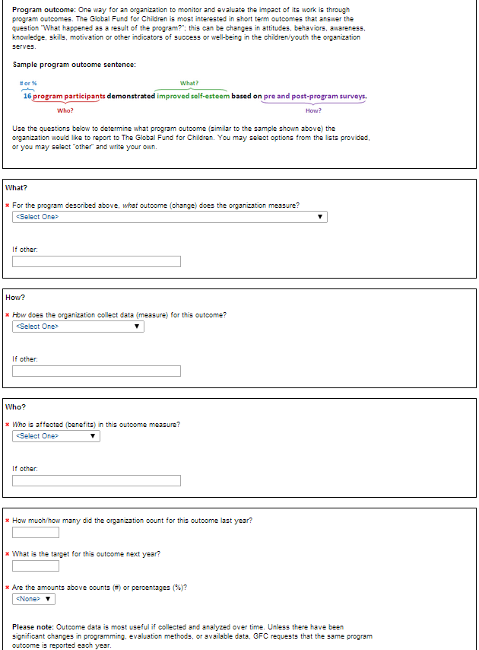
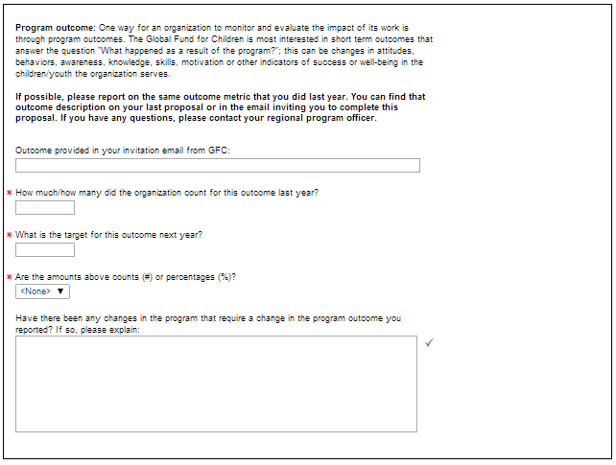
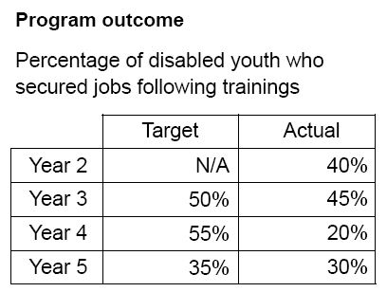
M&E for GFC: Outcome Sentences & Reports
Notes:
11. M&E for GFC
When filling out the grant application for GFC each year, you are required to input information about outcomes that your organization will report on to GFC. The outcome questions on the application are based on the logical framework and help you to determine what the key outcome of your program is and how well you are achieving it.
When filling out the initial request for a grant from The Global Fund for Children, you are asked questions like the ones shown here. [Click to advance, and the image will appear.] These first questions help your organization and your program officer to determine what you will report to The Global Fund for Children during your entire funding relationship with GFC. The questions are designed to help you develop a one-sentence program outcome that states what your organization does (the key goal/outcome), how your organization accomplishes this goal (activities and programs), who your organization serves (the specific population of children you work with), and how many children you have reached in the past year and hope to reach in the coming year. There are drop-down categories that can guide you, or you can type in your own answers. We’ll talk more about the creation of outcome sentences in the coming slides. [Click to advance, and this image will disappear.]
[Click to advance, and a new image will appear.]
For renewal and final grant applications, you are asked to report on the outcome that was determined by you and your program officer during the first year of your grant. In rare cases, the program outcome that an organization reports on may change, but this is not usual and makes monitoring your progress as an organization more challenging. When you report the number or percentage of children impacted by your program in your application, this information is sent to the staff and board of GFC so they can review your progress in a grant recommendation form. [Click to advance, and an example image will appear.]
For example, this organization reports its outcome as a percentage. [Read the program outcome in the example box.] As you can see, the organization’s success in increasing that percentage and reaching its goal varies from year to year. Accurately collecting this data for your outcome is a very important part of the application process.
Now let’s look at what makes a great outcome sentence both for GFC grant applications and for other potential donor applications.

Slide 12
SMART Measurements
Program outcome: Program goal
A program goal should be SMART
S = Specific
M = Measurable
A = Appropriate
R = Realistic
T = Timely
Notes:
12. SMART Measurements
One of the key terms we discussed earlier is the program outcome. A program’s outcome is a program’s goal, and to measure this goal, the outcome needs to be SMART. [Read the entire slide.]
Specific – define clearly what population you are working with, what your project is, and who is doing what in your organization
Measurable – something you can count or measure
Appropriate – matches the work you are doing and meets the needs of your community
Realistic – something you can accomplish with the resources you have
Timely – be specific about when you plan to accomplish your goals and realistic about when these goals can be met

Slide 13
Is This Outcome Sentence SMART?
Now You!
[5 minutes]
“Trafficked children went back to school.”
S: Specific – Yes and No. “Trafficked children” is specific, but how many are in school, and what kind of school do they go to?
M: Measurable – No. How many children went back to school?
A: Appropriate – Maybe. Are there children in the community who are trafficked and in need of formal schooling?
R: Realistic – Maybe. Can the organization reach the children and enroll them in school?
T: Timely – No. In what time frame did these children go back to school?
“Last year, 46 formerly trafficked children were reintegrated into formal schooling, based on school records.”
Notes:
13. Is This Outcome SMART?
Take five minutes to decide in your group whether or not this outcome is SMART.
You can look at question 3 on the worksheet.
[After three minutes, ask participants to tell you if they’ve completed the activity, using + or -. After five minutes, click to advance, and the revised outcome will appear.]
The revised outcome is SMART because it is specific (46 formerly trafficked children), measurable (46 children last year), appropriate and realistic (we assume this outcome sentence addresses needs in the community and that the organization has the inputs necessary to do the project), and timely (a one-year period is specified).

Slide 14
Outcome Sentence for GFC
What? (1)
# or % (4)
What? (1)
# or % (4)
Last year, 66% of program participants were successfully enrolled in formal school, based on statistics from local schools.
Last year, 66% of program participants were successfully enrolled in formal school, based on statistics from local schools.
Who? (3)
Who? (3)
How? (2)
How? (2)
1. For the program you run, what outcome (change) does the organization measure?
2. How does the organization collect data for (measure) this outcome?
3. Who is affected (benefits) in this outcome measure?
4. How much/how many did the organization count for this outcome last year?
What
How
Who
When
How many
Notes:
14. Outcome Sentences for GFC
Here is the formula that GFC uses in its grant application or “proposal”. The grant application asks you questions to help you create an outcome sentence. Notice how the example outcome sentence is SMART.
Specific – enrolled in formal school
Measurable – statistics from local schools are used to calculate the percentage of school-going children (66%) in the program
Appropriate – program participants (not others) (We assume that this project meets the needs of the program participants.)
Realistic – depends on the organization—is 66% achievable?
Timely – one year (“last year,” which is GFC’s standard outcome period )
The questions that GFC asks to help you determine your outcome sentence are:
1. For the program you run, what outcome (change) does the organization measure?
2. How does the organization collect data for (measure) this outcome?
3. Who is affected (benefits) in this outcome measure?
4. How much/how many did the organization count for this outcome last year?

Slide 15
Put the Parts of This Outcome Sentence in the Correct Order
Now You!
based on employment records
last year
successfully secured jobs following training
55% of disabled youth
Last year, 55% of disabled youth successfully secured jobs following training, based on employment records.
[2 minutes]
# or %
What?
Last year, 66% of program participants were successfully enrolled in formal school, based on statistics from local schools.
Who?
How?
Notes:
15. Practice Ordering Outcome Sentence
Now that we’ve looked at how outcome sentences are constructed for GFC, it’s time to practice. You have two minutes to work in your group to try to put this sentence together. Look at question 4 on the worksheet.
[After 1.5 minutes, ask participants to tell you if they’ve completed the activity, using + or -. When most have finished, click and the correct order will appear on the screen.]

Slide 16
Practice: Write an Outcome Sentence for GFC
Now You!
[6 minutes]
Use the questions below to determine what program outcome your organization would like to report to The Global Fund for Children.
1. For the program you run, what outcome (change) does the organization measure?
2. How does the organization collect data for (measure) this outcome?
3. Who is affected (benefits) in this outcome measure?
4. How much/how many did the organization count for this outcome last year?
Last year, _(4)__ of (3) were (1) , based on (2) .
Notes:
16. Practice Writing an Outcome Sentence
[Give examples from past grant applications (chosen by the program officer).]
Now it’s your turn to work on a project outcome sentence for your organization. Work as a group and decide what your outcome sentence will look like. You have six minutes. If you’re not sure about your sentence or would like help with writing it, make sure to email your program officer later with your sample and any questions you have. Look at question 5 on the worksheet.
[After three or four minutes, ask participants to tell you if they’ve completed the activity, using + or -.]

Slide 17
Collecting Data
Why?
Makes monitoring and evaluation possible
Where can you get data from?
Your own records
Local organizations
Tools: Questions to consider
Who collects the data, how is it collected, and when is it collected?
Where is the data stored, and how is it organized?
Other resources:
My M&E website on how to collect data:
http://www.mymande.org/howto-recomm-page?q=node/94
Keep track of the resources, number of participants, and what happened during your program in a consistent and repeatable way.
Notes:
17. Introduction to Collecting Data
You can collect data from a variety of sources. Most organizations collect data by keeping good records of things like attendance, participation, surveys, and financial records.
You can also work with other local organizations, either NGOs or the government. For example, you can talk with schools about pass rates or clinics about overall statistics.
To collect good data, you need to have the right tools. Often the right tools means collecting data in a way that no matter who collects the data, it will be the same. Data should be collected in the same way each time. It helps if you set up a procedure so that you know who is collecting data, when they will collect it, and how they will collect it.
For example, if you want to count the number of children who attend your after-school programs throughout the week, you should know who will make sure all of the children sign in each day and when they will be required to sign in, and you should make sure that they are using the same form each time. That way, you can compare information from month to month and year to year.
After data is collected, you have to know how it will be stored and organized. For different organizations, that could mean different things, but it often means having a spreadsheet in Excel or in another computer program that has all of the information and is updated often.
Finally, it is important to use the data you’ve collected. By having data over a period of time, you can see trends and make decisions based on what you find. For example, you may notice that not as many children come to a soccer practice on Mondays, but you have almost too many children attending soccer practice on Saturdays. After speaking with the children to determine why this is, you can change your program by having more coaches on Saturdays and either changing the time of the Monday practice or having less coaches on Mondays.
Here are three common challenges to collecting data:
-First, not all outcomes are easily countable. There might be changes in behavior or attitude that have to be measured in different ways.
-Second, some outcomes take more than a year to become evident.
-Third, it can be difficult to measure what the impact of your program is. For example, it’s fairly easy to tell how many of the children you work with are going to school, but if you are trying to reduce trafficking, how do you measure your influence in that area?
For more information on how to address these challenges, see the link provided on this slide and the other resources on the next slide.

Slide 18
Additional Resources
M&E Learning Center
https://training.measureevaluation.org
My M&E
http://www.mymande.org/elearning
Global Health E-Learning
http://www.globalhealthlearning.org
Children & Evaluation
http://betterevaluation.org/themes/evaluation_and_children
M&E Studies
http://mnestudies.com
Pan Asia-Africa RBM&E Forum
http://learnmandeforum.com
Notes:
18. Additional Resources
Here are some additional resources to help you learn more about monitoring and evaluation. There are more webinars and tools available to help you collect data and measure your impact. This is not a complete list of all of the resources available; if you know of another great M&E training, please let us know so we can share it with other grantees. After the webinar, you will be able to download this presentation so that you can click on the links shown in this slide.

Slide 19
Please write down three changes you can make that will improve M&E for your organization.
What Did You Learn?
What changes can you make in your work today?
Now You!
[5 minutes]
Notes:
19. Reflection
We’ve talked about a lot of different subjects during this webinar. Take five minutes and write down three changes you can make in your programs today, on question 6 of the worksheet. You’ll be asked to write these down again on the survey at the end of this webinar, so think hard!
[After three minutes, ask participants to tell you if they’ve completed the activity, using + or -.]

Slide 20
Thank you
Please take the follow-up survey!
Contact: Sarah Ellison
sellison@globalfundforchildren.org
Notes:
20. Thank you
Thank you for participating in this webinar. In order to receive your ML&E certificate from GFC, you must complete the survey link: https://www.surveymonkey.com/s/LZ3TBG8.
[Type link into chat box.]
Please click on the link in the chat screen, and it will take you to the survey now. If you have any questions about the information we talked about today, please do not hesitate to contact your regional program officer. Thank you!

